Slide 1

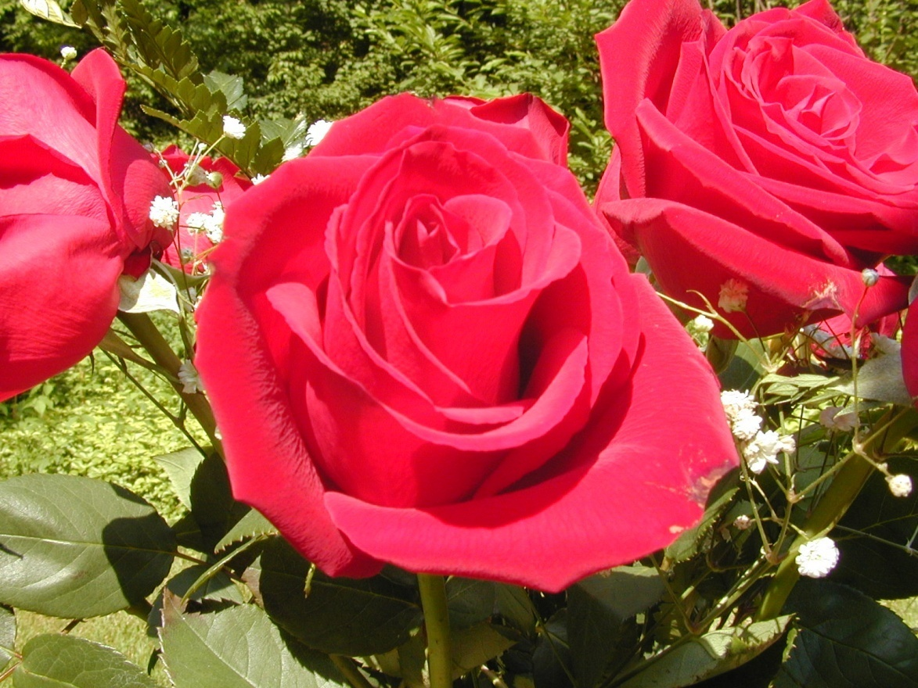
WELCOME

Slide 2

Presented by -
Asma Akter
Assistant Teacher
Baira Govt Primary School
Muradnagor, Comilla.

Slide 3

Class-2
Subject –English
Unit -5
Lesson -2
Page No –29
Time -40 Minitues

Slide 4
Learning Outcomes
Student,s will be able -
1. to become familiar with English sounds by
listening some colours name.
2. to repeat after the teacher with proper sounds
and stress.

Slide 5


Slide 6

Title of the lesson
Colours(2)

Slide 7
Presentation Time:25 min

Slide 8
Showing Real objects :
Banana
Red Rose
Bringle
Sky
Leaf
Orange

Slide 9
Look and say about the colour of the picture:

Slide 10
Look and say about the colour of the picture:

Slide 11
Teacher’s reading with pointing:
Violet
Indigo
Blue

Slide 12
Green
Yellow
Orange
Red

Slide 13
Students say with teacher
Violet
Orange
Indigo
Green
Blue
Red
Yellow

Slide 14
Students say in group
Red
Violet
Yellow

Slide 15
Ss say individual
Green
Blue
Orange
Indigo

Slide 16

Evaluation
How many colours do you find in the rainbow?

Slide 17
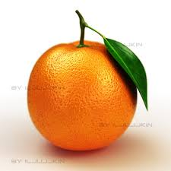
Green
Orange
Red
Yellow

Slide 18

Thanks for all

